Slide 1
Getting To Decide!
Jen Schellinck, Sysabee, March 2026

Slide 2

Workshop Housekeeping

Slide 3
Housekeeping: Workshop Expectations and Suggestions
Please no recording of the workshop, in order to preserve participant privacy.
Try to have something available for light note-taking.
Please participate in group exercises, and mix up groups. Feel free to anonymize any info or examples you provide.
Feel free to take stretch or washroom breaks at any time!

Slide 4
A Word About AI
I’ve designed the activities in this workshop to be carried out by people under their own power.
I’m not going to prohibit people from using AI during workshop activities.
I would encourage people to actively evaluate and consider the quality of any material they get via AI.
Also consider the construction site vs gym analogy. And be respectful of other people’s preferences on this front.

Slide 5
We are born to be good (fast!) decision makers. We’re (literally!) here because our ancestors made good decisions in the face of uncertainty.
(and were lucky!)

Slide 6

Our brains are wired for good decision making.
(under many circumstances)

Slide 7
We’re shaped by evolution and how that has structured our innate decision-making strategies.

Slide 8
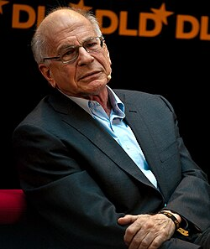
Daniel Kahnman
Wrote thinking Fast, Thinking Slow (2011)
Posited that we have two thinking systems:
  System 1: Quick decisions using baked in cognitive heuristics
  System 2: Deliberate decisions using explicit reasoning system.
Key question: When is it worth the effort to use system 2?

Slide 9
Making decisions using system 1, with evidence and data, is hard - and hard to get people to do. It’s (mostly) not what we’ve evolved to do.

Slide 10
And we’re not omniscient. We can’t see into the future.
Is it possible to overcome these limitations?
Can we get even better at decision making under uncertainty?

Slide 11
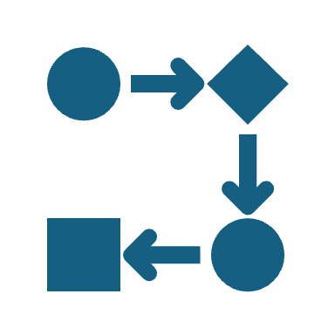
It’s not all or nothing.
We can develop information supported strategies and approaches that will pay dividends with respect to the outcome of our decisions.
By becoming aware of and practicing these strategies you can move towards becoming the best decision maker you can be.

Slide 12
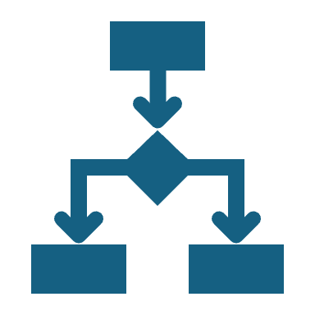
Ten Short Consequence Tree Steps to Fact-
Supported Decision Making

Slide 13
Creating a “Consequence Tree”
Suppose someone comes to you and offers you either a blueberry muffin or a carrot walnut muffin.
What might the possible “tree” of choices + consequences look like? Which consequences represent good outcomes?
Situation
Possible Choices
Possible Consequences
Good Outcomes

Slide 14
Imagining Possible Worlds…
Different statements describe different possible worlds.
Facts determine which of these world is, or will be, the real world.
Situation
Possible Choice
Possible Consequence
Good Outcomes

Slide 15
Creating a Consequence Tree:
Steps 1 - 5
Step 1
The Decision Situation (~10 Minutes)
Step 2
Values and Other Considerations (~15 Minutes)
Step 3
Goals and Issues (~15 Minutes)
Step 4
Start Your Knowledge Bank (~15 minutes)
Step 5
Possible Choices of Action (25 minutes)

Slide 16
Consequence Tree:
Steps 6 - 10
Step 6
Action Facts (15 minutes)
Step 7
Possible Outcome Scenarios (20 minutes)
Step 8
Outcome Scenarios Key Facts (30 minutes)
Step 9
Outcome Scenario Quality (15 minutes)
Step 10
Evaluate First-Step Actions (15 minutes)

Slide 17
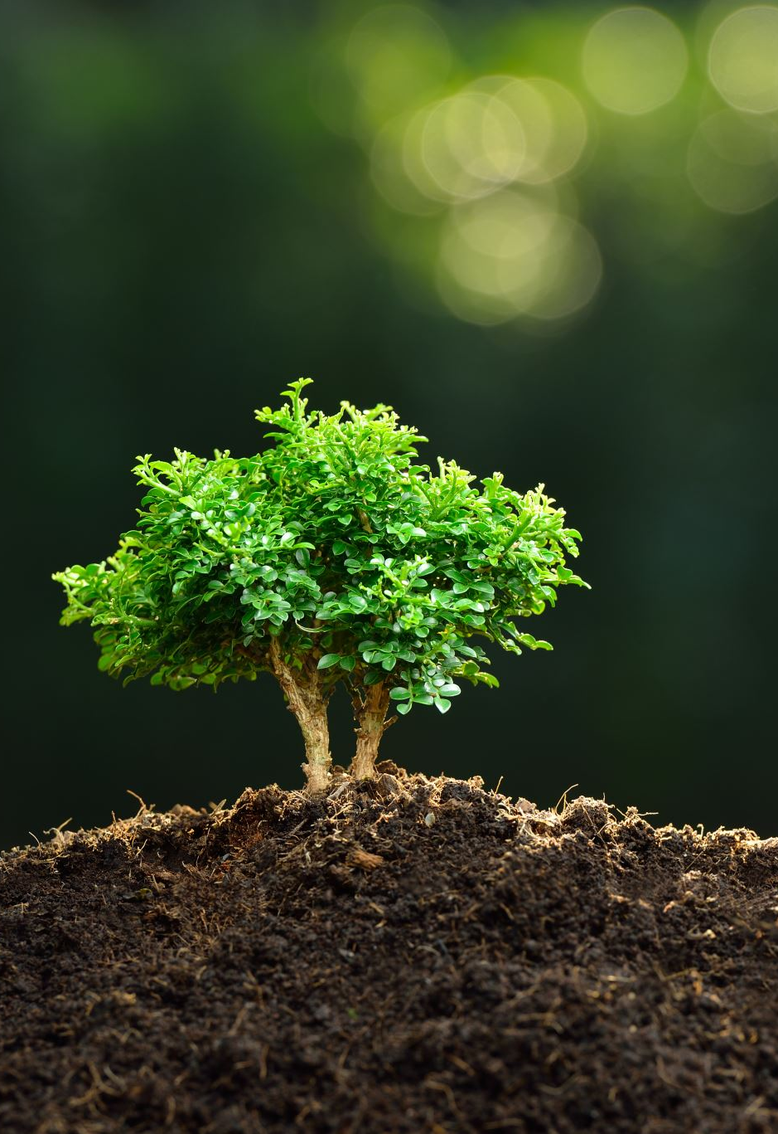
Consequence Tree Worksheets
https://www.sysabee.com/index.php/getting-to-decide-workshop/

Slide 18
Decision Situation
First-Step Actions
Outcome Scenarios
Name:
Strong:
Weak:
Likeliness:
Name:
(A)
(1)
Name:
Strong:
Weak:
Likeliness:
Evaluation:
(B)
Name:
Strong:
Weak:
Likeliness:
Name:
Name:
(C)
(2)
Name:
Strong:
Weak:
Likeliness:
Evaluation:
(D)
Name:
Strong:
Weak:
Likeliness:
Name:
(E)
(3)
Name:
Strong:
Weak:
Likeliness:
Evaluation:
(F)
Consequence Tree Worksheet

Slide 19
Decision Situation Description
Write down whatever springs to your mind about your current decision situation and context.
Name:

Slide 20
Values and Considerations List
Create a list of statements (full sentences) that describe values, priorities, wants, needs, likes, dislikes, situations to avoid, constraints, mission statements and any other considerations for this decision.

Slide 21
Decision-Making Motivator
Describe what is motivating your decision-making activity. This could be a problem, situation, question or desired outcome.
“My decision motivator is…”

Slide 22
Goal Description
Based on your goal motivator, describe your goal(s). If you have multiple goals, rank them in order of priority.

Slide 23
Knowledge Bank
Record facts relevant to your situation, choices of action and consequences. Include value statements. Think about the objects and actions involved and collect facts related to these.

Slide 24
Knowledge Bank (cont.)
Record facts relevant to your situation, choices of action and consequences. Include value statements. Think about the objects and actions involved and collect facts related to these.

Slide 25
Choices of Action – Brainstorming
List five to ten different, independent, first steps you could take, starting from your current decision situation. Include both choices of action you want take and choices of action you wouldn’t want to take. Note which actions you like and which ones you dislike. Note your favourite option.

Slide 26
Three First-Step Actions
List three first-step actions from your choices of action brainstorming step that you will explore in depth.
Name:
First-Step Action 1
Name:
First-Step Action 2
Name:
First-Step Action 3

Slide 27
Consequence Scenarios
For each of your three choices of action, describe a positive consequence scenario and a negative consequence scenario. Give each scenario a distinct and memorable name.
Name:
Positive Consequence Scenario (A)
First-Step Action 1
Name:
Negative Consequence Scenario (B)

Slide 28
Consequence Scenarios
For each of your three choices of action, describe a positive consequence scenario and a negative consequence scenario. Give each scenario a distinct and memorable name.
Name:
Positive Consequence Scenario (C)
First-Step Action 2
Name:
Negative Consequence Scenario (D)

Slide 29
Consequence Scenarios
For each of your three choices of action, describe a positive consequence scenario and a negative consequence scenario. Give each scenario a distinct and memorable name.
Name:
Positive Consequence Scenario (E)
First-Step Action 3
Name:
Negative Consequence Scenario (F)

Slide 30
Consequence Scenario Likeliness
Using your knowledge base for inspiration, make a list of at least three strengthening facts and three weakening facts for your consequence scenarios. Calculate a strengthening, weakening and likeliness Ratings for the consequence scenario based on these lists. Copy the resulting ratings into the Consequence Tree Worksheet.
Strengthening Facts
Name:
Strengthening Rating:
Consequence Scenario (A)
Likeliness Rating:
Weakening Facts
Weakening Rating:

Slide 31
Consequence Scenario Likeliness
Using your knowledge base for inspiration, make a list of at least three strengthening facts and three weakening facts for your consequence scenarios. Calculate a strengthening, weakening and likeliness Ratings for the consequence scenario based on these lists. Copy the resulting ratings into the Consequence Tree Worksheet.
Strengthening Facts
Name:
Strengthening Rating:
Consequence Scenario (B)
Likeliness Rating:
Weakening Facts
Weakening Rating:

Slide 32
Consequence Scenario Likeliness
Using your knowledge base for inspiration, make a list of at least three strengthening facts and three weakening facts for your consequence scenarios. Calculate a strengthening, weakening and likeliness Ratings for the consequence scenario based on these lists. Copy the resulting ratings into the Consequence Tree Worksheet.
Strengthening Facts
Name:
Strengthening Rating:
Consequence Scenario (C)
Likeliness Rating:
Weakening Facts
Weakening Rating:

Slide 33
Consequence Scenario Likeliness
Using your knowledge base for inspiration, make a list of at least three strengthening facts and three weakening facts for your consequence scenarios. Calculate a strengthening, weakening and likeliness Ratings for the consequence scenario based on these lists. Copy the resulting ratings into the Consequence Tree Worksheet.
Strengthening Facts
Name:
Strengthening Rating:
Consequence Scenario (D)
Likeliness Rating:
Weakening Facts
Weakening Rating:

Slide 34
Consequence Scenario Likeliness
Using your knowledge base for inspiration, make a list of at least three strengthening facts and three weakening facts for your consequence scenarios. Calculate a strengthening, weakening and likeliness Ratings for the consequence scenario based on these lists. Copy the resulting ratings into the Consequence Tree Worksheet.
Strengthening Facts
Name:
Strengthening Rating:
Consequence Scenario (E)
Likeliness Rating:
Weakening Facts
Weakening Rating:

Slide 35
Consequence Scenario Likeliness
Using your knowledge base for inspiration, make a list of at least three strengthening facts and three weakening facts for your consequence scenarios. Calculate a strengthening, weakening and likeliness Ratings for the consequence scenario based on these lists. Copy the resulting ratings into the Consequence Tree Worksheet.
Strengthening Facts
Name:
Strengthening Rating:
Consequence Scenario (F)
Likeliness Rating:
Weakening Facts
Weakening Rating:

